Slide 1



“From Caesar to Vigenère: The Evolution of Substitution Ciphers in Cryptography”
CSA5116 - CRYPTOGRAPHY AND NETWORK SECURITY
presented By : T Sri Ram Chandu
Reg No : 192412586
Guided By : Dr Sudhagar D

Slide 2

Introduction
Cryptography is the science of protecting information by converting readable data into a secret form called ciphertext.
Substitution ciphers are classical encryption techniques that replace plaintext letters with other letters or symbols using a specific rule or key.
The Caesar Cipher introduced a simple shift-based approach, where each letter is replaced by another letter at a fixed position in the alphabet.
The Vigenère Cipher improved this concept by using multiple alphabetic shifts based on a keyword, making encryption significantly stronger than a simple Caesar shift.

Slide 3
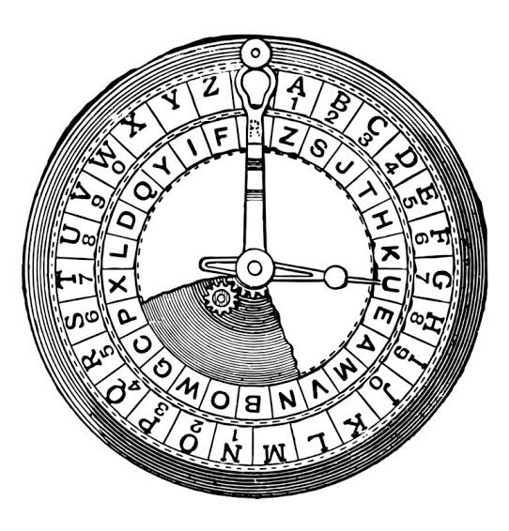
CAESAR CIPHER
What is Caesar Cipher?
The Caesar Cipher is one of the oldest and simplest substitution ciphers.
It replaces each letter with another letter using a fixed shift value.
The same shift is applied to every letter in the message.
It is named after Julius Caesar, who reportedly used it for military communication

Slide 4
LIMITATIONS OF CAESAR CIPHER
Why is Caesar Cipher Weak?
Small Key Space: Only 25 possible shifts are available.
Easy Brute-Force Attack: An attacker can simply try every possible shift.
Fixed Substitution: Every letter is always replaced by the same letter.
Frequency Analysis: Common letters and patterns can reveal the original message.
Predictable Patterns: Repeated letters and words remain recognizable.
Low Security: Suitable for basic or historical communication, but not secure for modern applications.

Slide 5
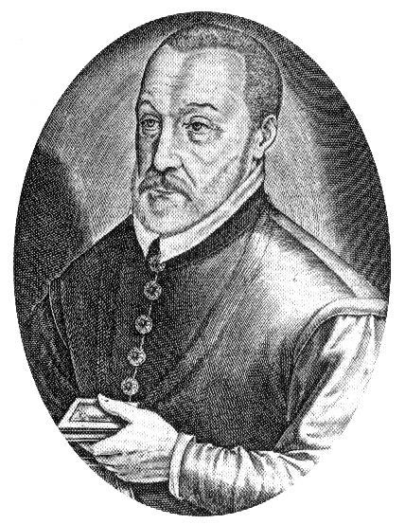
VIGENÈRE CIPHER
What is Vigenère Cipher?
The Vigenère Cipher is a classical polyalphabetic substitution cipher.
It was developed to overcome the weaknesses of the Caesar Cipher.
Instead of using one fixed shift, it uses a keyword to determine different shifts.
The same plaintext letter can be encrypted into different ciphertext letters.
It uses a Vigenère Table (Tabula Recta) containing multiple Caesar-shifted alphabets.

Slide 6
CAESAR vs VIGENÈRE: THE EVOLUTION
Feature | Caesar Cipher | Vigenère Cipher
Cipher Type | Monoalphabetic | Polyalphabetic
Key | Fixed shift | Keyword
Substitution | One alphabet | Multiple alphabets
Shift | Same for every letter | Changes based on key
Security | Low | Higher
Brute-Force Resistance | Very low | Higher
Main Weakness | Easy to break | More complex to analyze

Slide 7
CONCLUSION
Key Takeaways :
Caesar Cipher introduced a simple method of encryption using a fixed alphabetic shift.
Its limited key space and predictable patterns made it easy to break.
Vigenère Cipher improved security by using a keyword and multiple substitution alphabets.
The transition from Caesar to Vigenère shows the evolution of substitution ciphers toward stronger encryption.
These classical techniques helped establish important concepts used in the development of modern cryptography.

Slide 8


